Slide 1



enlight
An optimized raycasting approach for subtractive manufacturing simulation and visualization

Slide 2
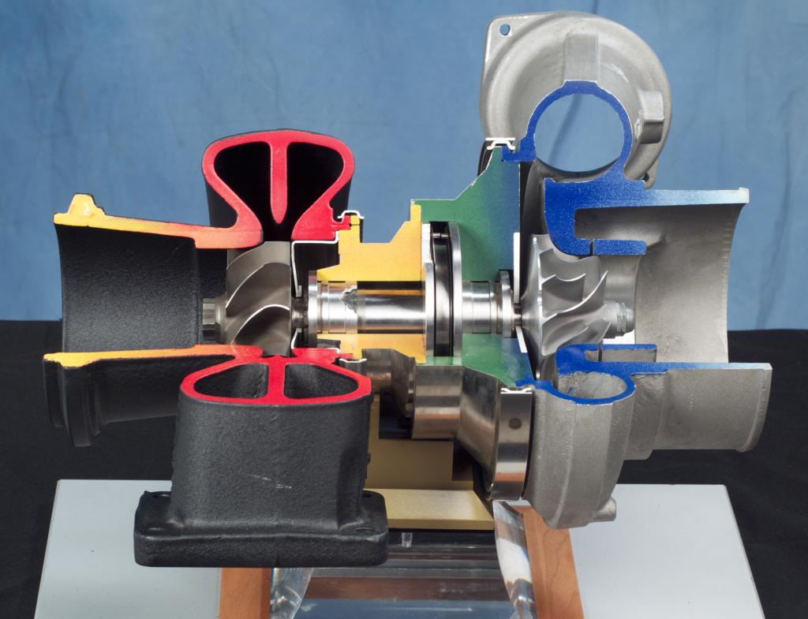
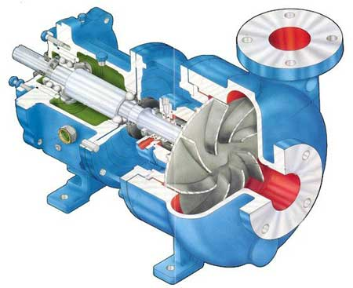
Industrial components e.g. impellers
http://www.globalpumps.in/matherplatt.html
http://en.wikipedia.org/wiki/File:Turbocharger.jpg

Slide 3

Milling - Subtractive manufacturing
Adapted from: https://www.youtube.com/watch?v=P0ImcDi_B0o

Slide 4
Overview
Problem specification
Basic visualization approach
Optimization I, II, III
Results

Slide 5
Problem specification

Slide 6
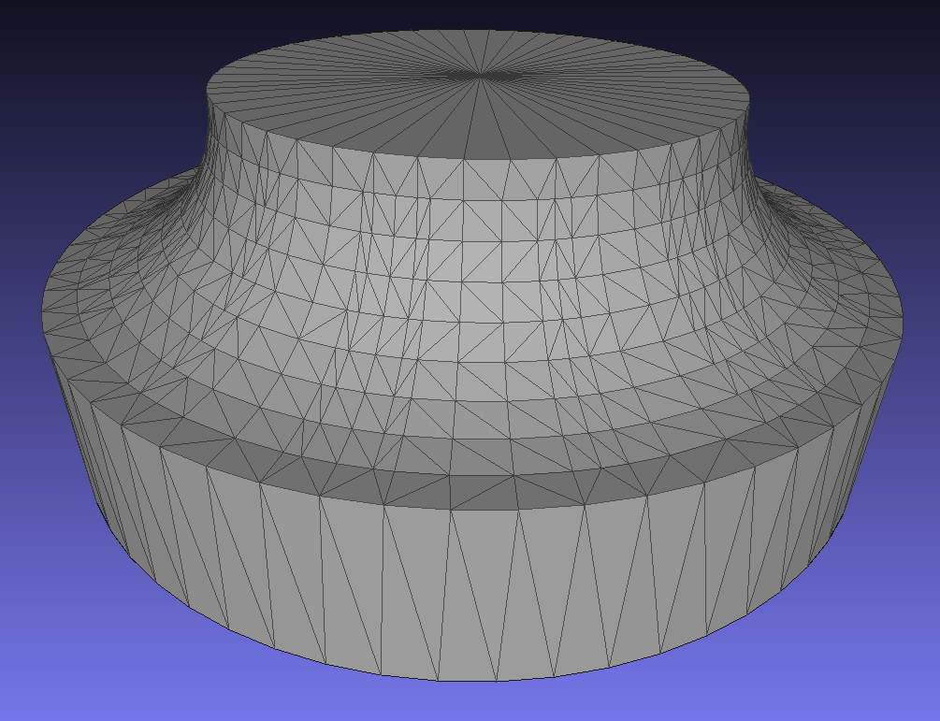
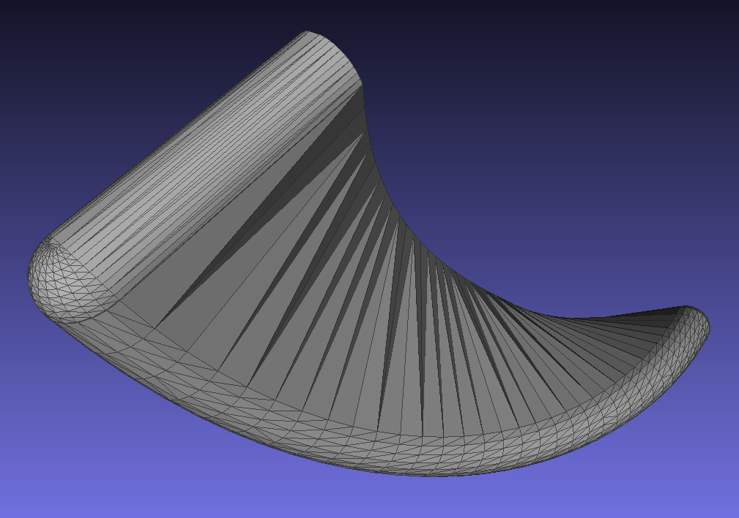
Input for digital simulation
MeshLab screen shots of low resolution input meshes

Slide 7
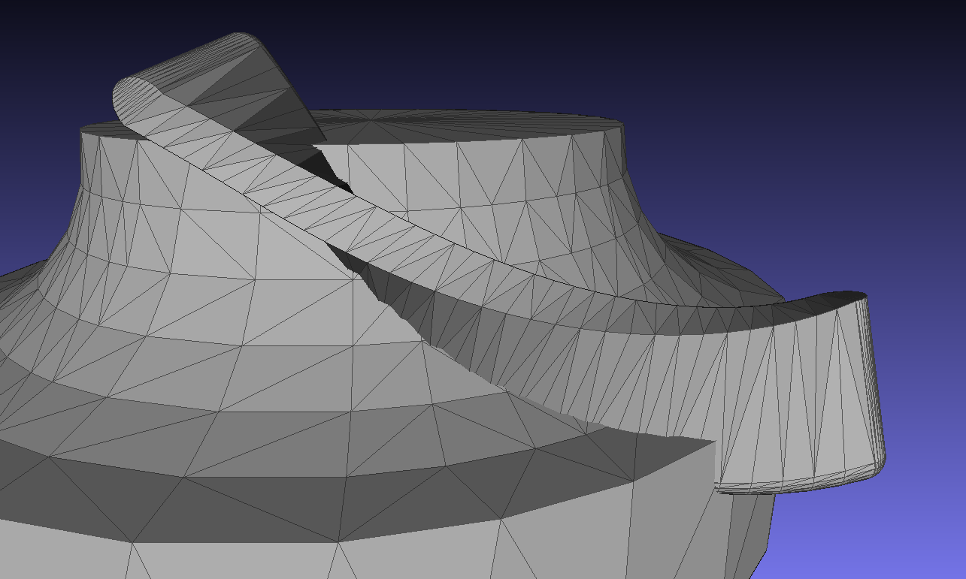
Problem
MeshLab screen shots of low resolution input meshes

Slide 8
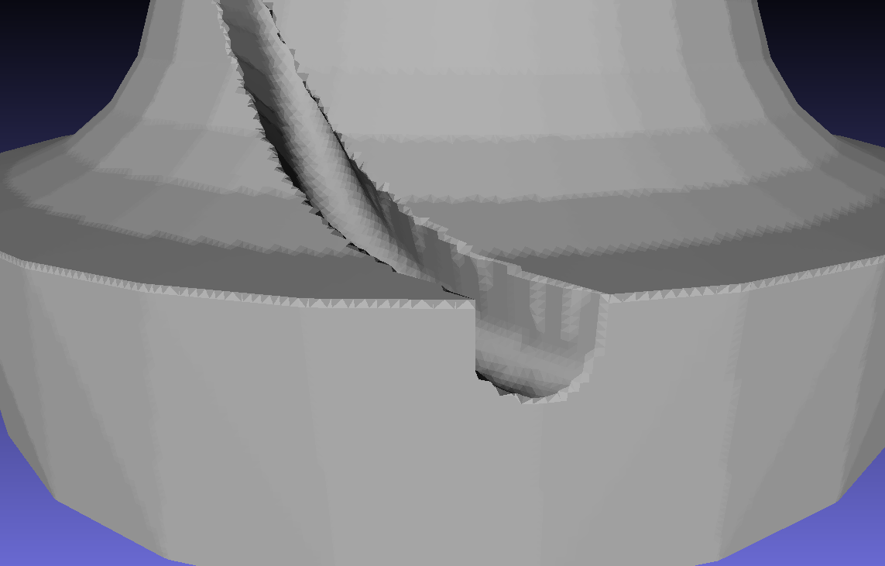
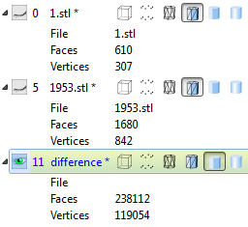
Existing methods – e.g. marching cubes
Explicit surface calculation using MeshLab

Slide 9
Basic visualization approach

Slide 10
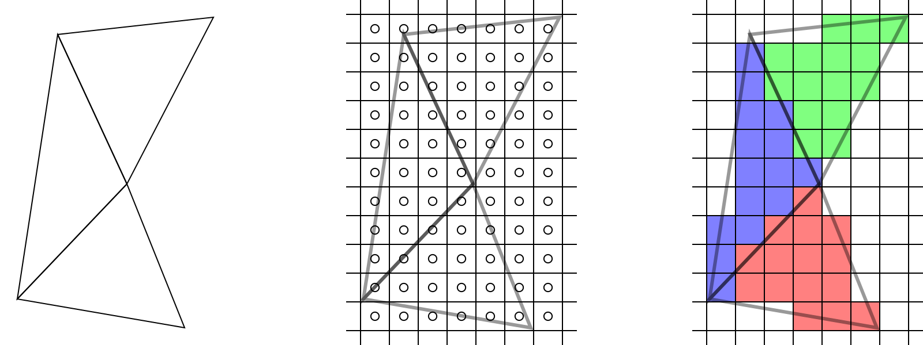
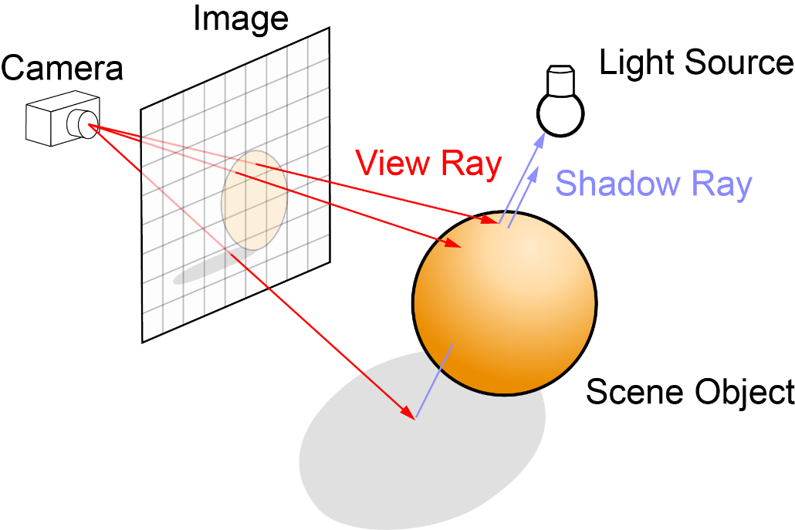
Rendering 3D geometry
Rasterization (OpenGL, DirectX)
Ray tracing/casting
http://www.arcsynthesis.org/gltut/basics/Intro%20Graphics%20and%20Rendering.html
http://en.wikipedia.org/wiki/Ray_tracing_(graphics)#mediaviewer/File:Ray_trace_diagram.svg

Slide 11
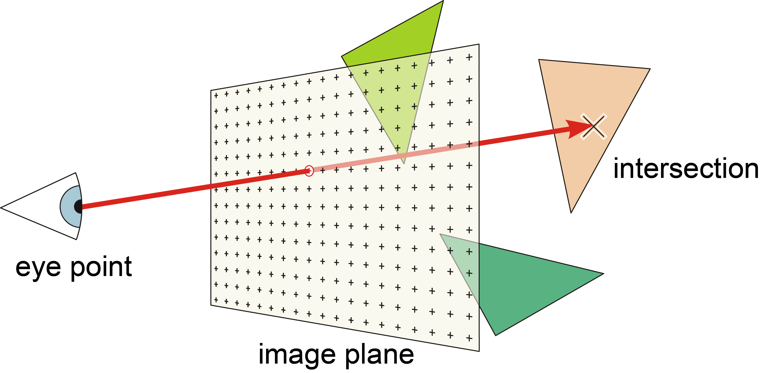
Ray casting
http://de.academic.ru/dic.nsf/dewiki/1163221

Slide 12
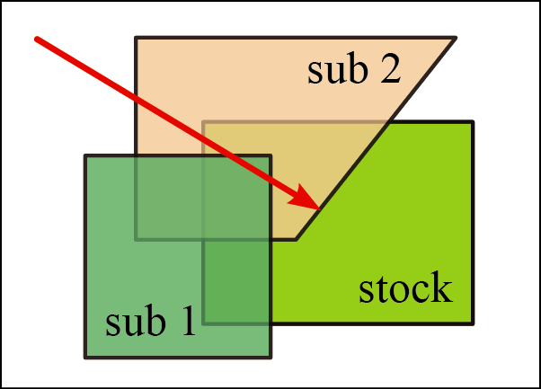
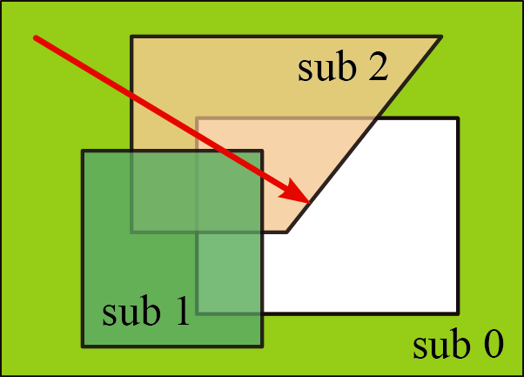

Swept volumes - entry/exit counting

Slide 13
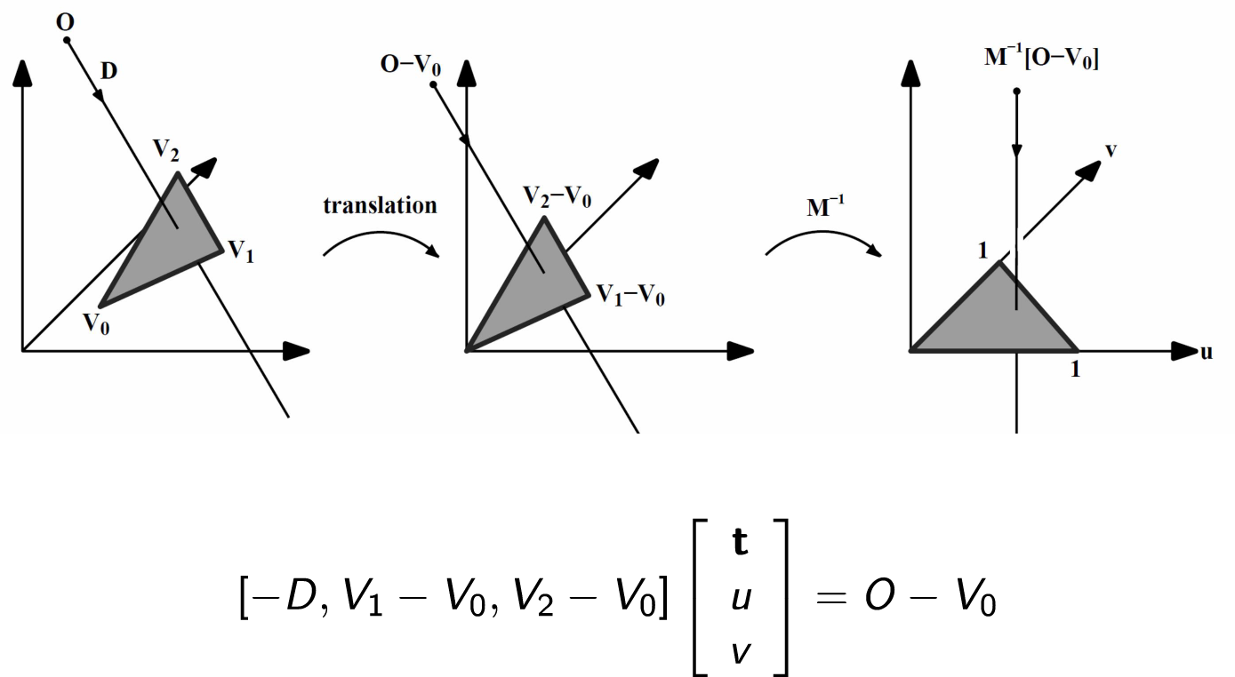
Triangle ray intersection
Fast, Minimum Storage Ray/Triangle Intersection, Möller & Trumbore, 1997
Image: Torsten Welsch

Slide 14
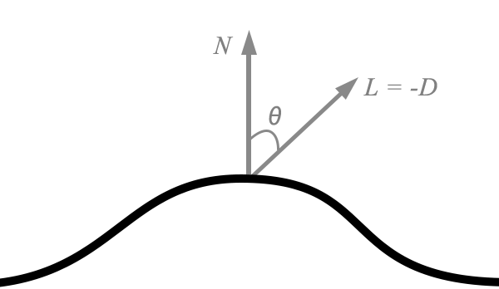
Result
Per ray/pixel
Distance/position
Normal vector of hit triangle
http://metalbyexample.com/up-and-running-3/

Slide 15
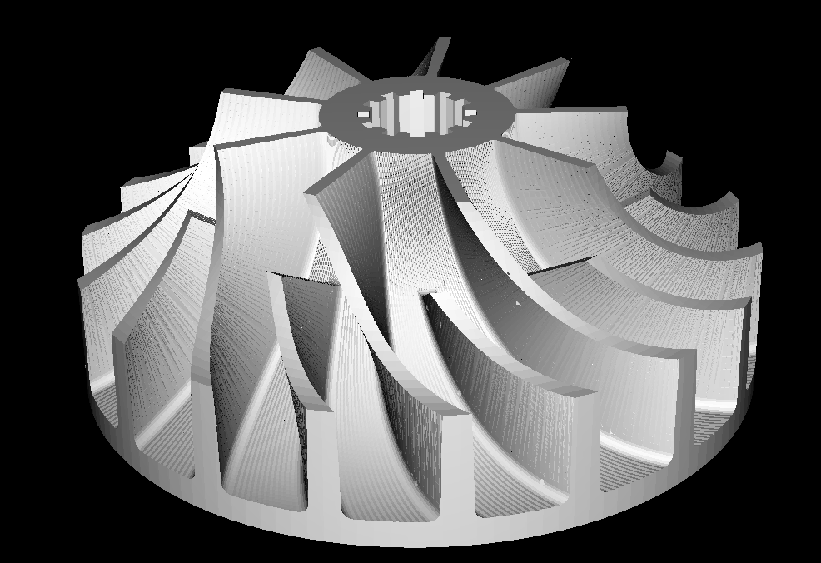
OpenGL integration - Composition
Write calculated color values directly to frame buffer (glDrawPixels)
Fast
Color calculation entirely on CPU

Slide 16
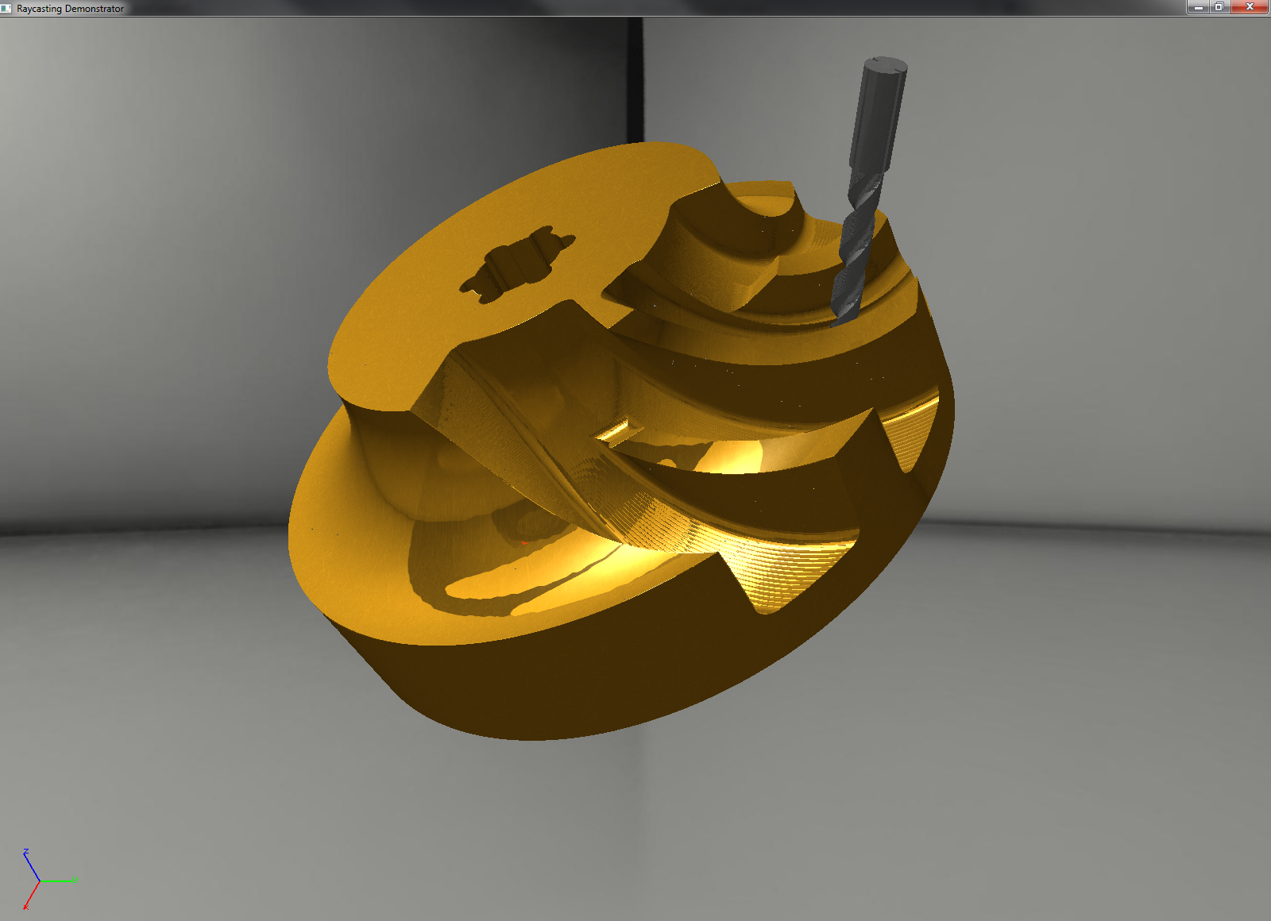
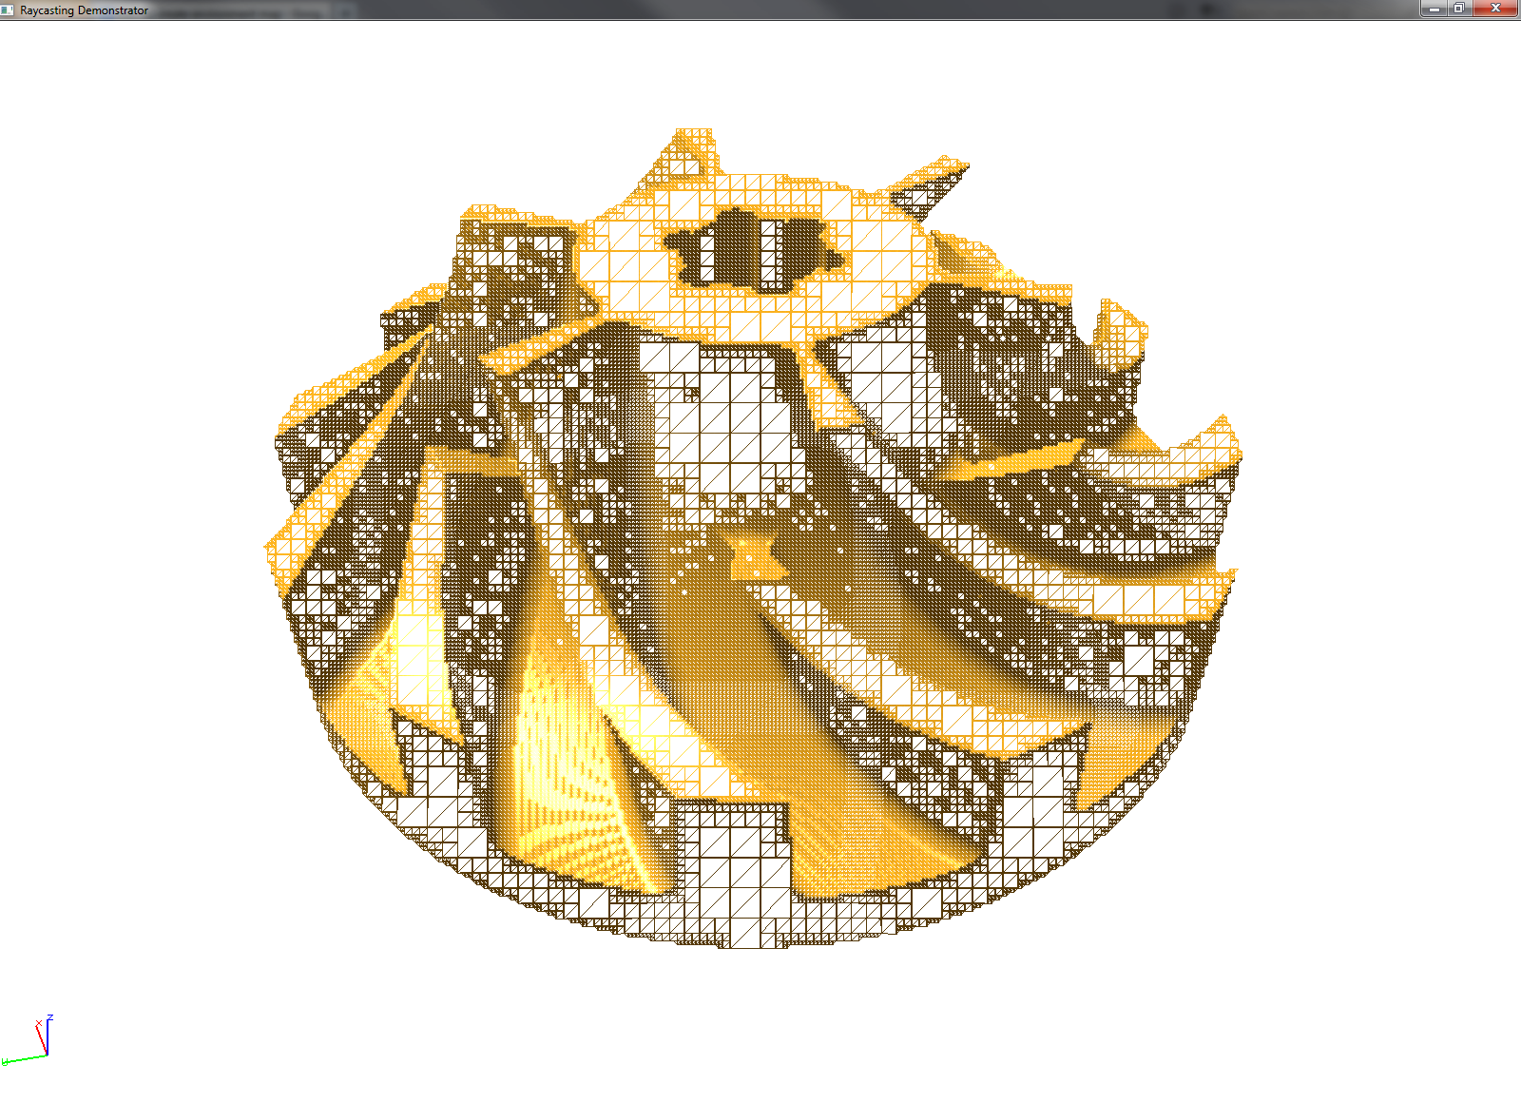
OpenGL integration - Retriangulation
Triangulation on CPU
Full graphics pipeline on GPU

Slide 17
Optimization I
Reducing intersection tests

Slide 18
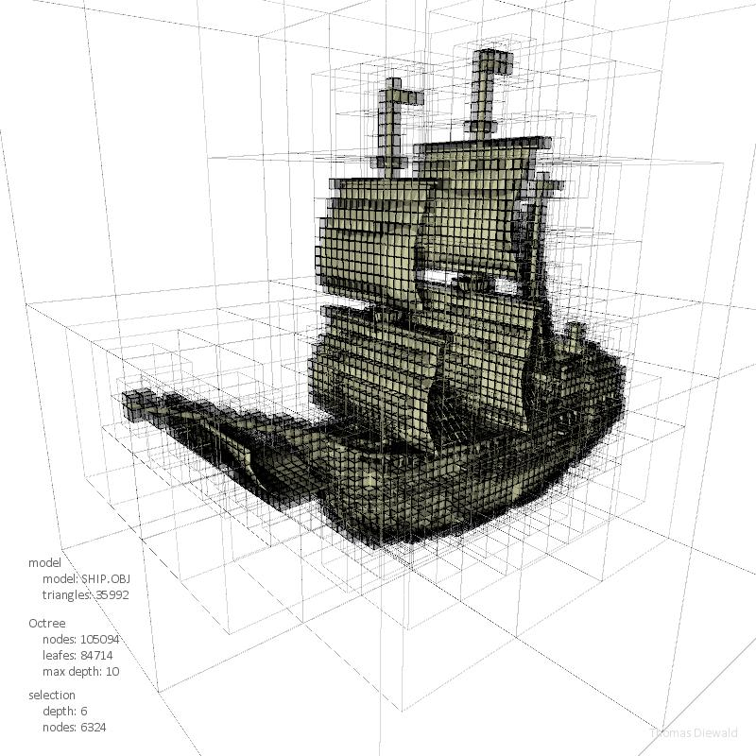
Acceleration structures
Trees
K-d trees
Octrees
Bounding volume hierarchy
Regular grids
http://thomasdiewald.com/blog/?p=1488

Slide 19
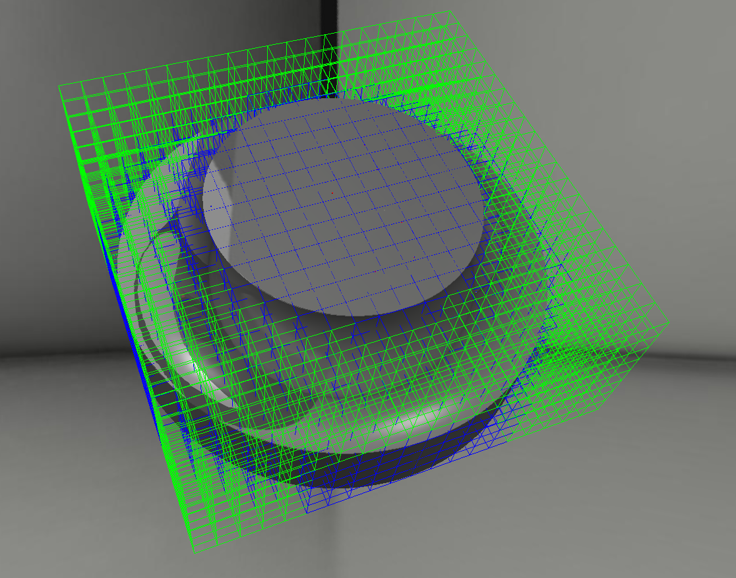
Regular grid
Simple
Fast modifications

Slide 20
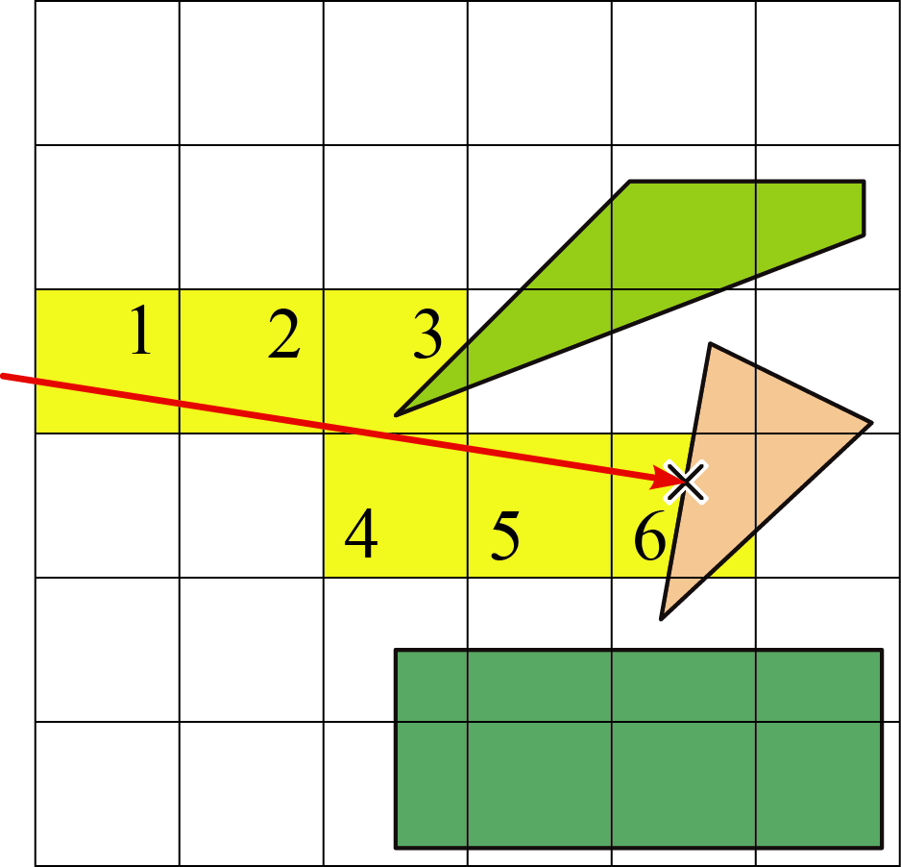
Traversal – 3D DDA
A fast voxel traversal algorithm for ray tracing, John Amanatides and Andrew Woo, 1987

Slide 21
Optimization II
Reducing triangle count

Slide 22
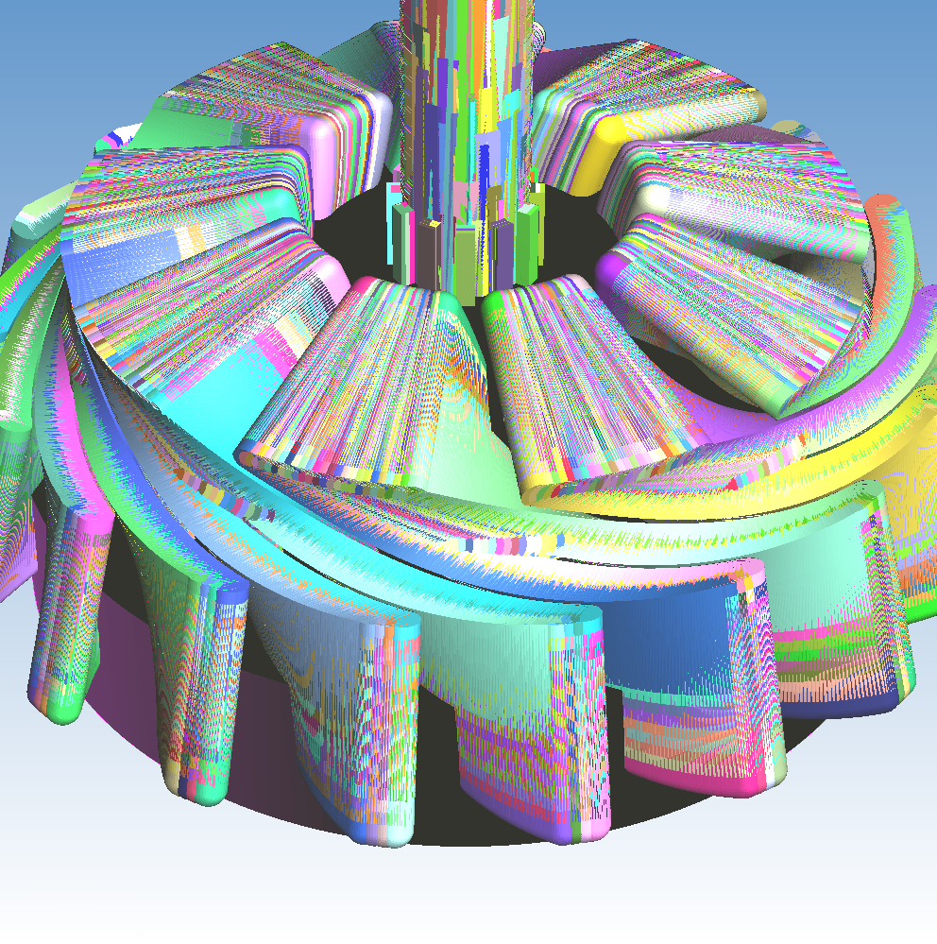
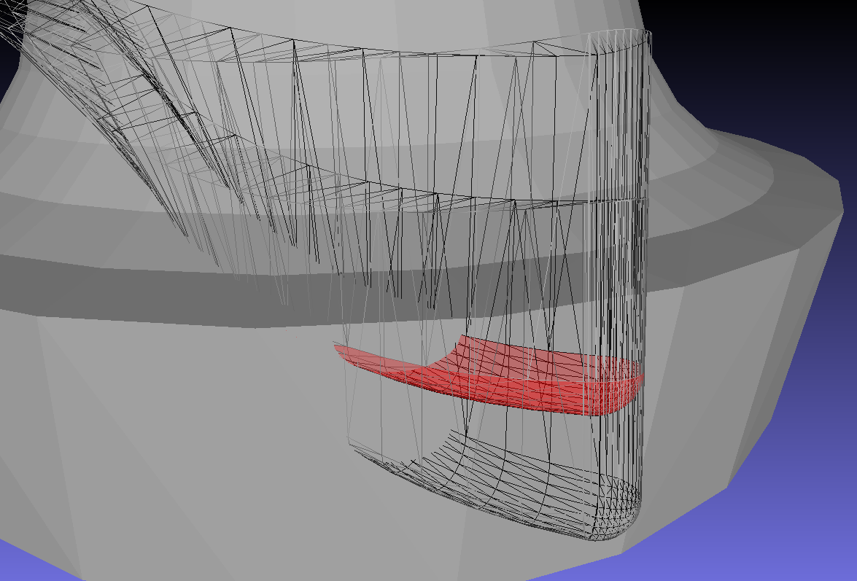
Optimizing triangle count
Screen shot of selected triangles in MeshLab

Slide 23
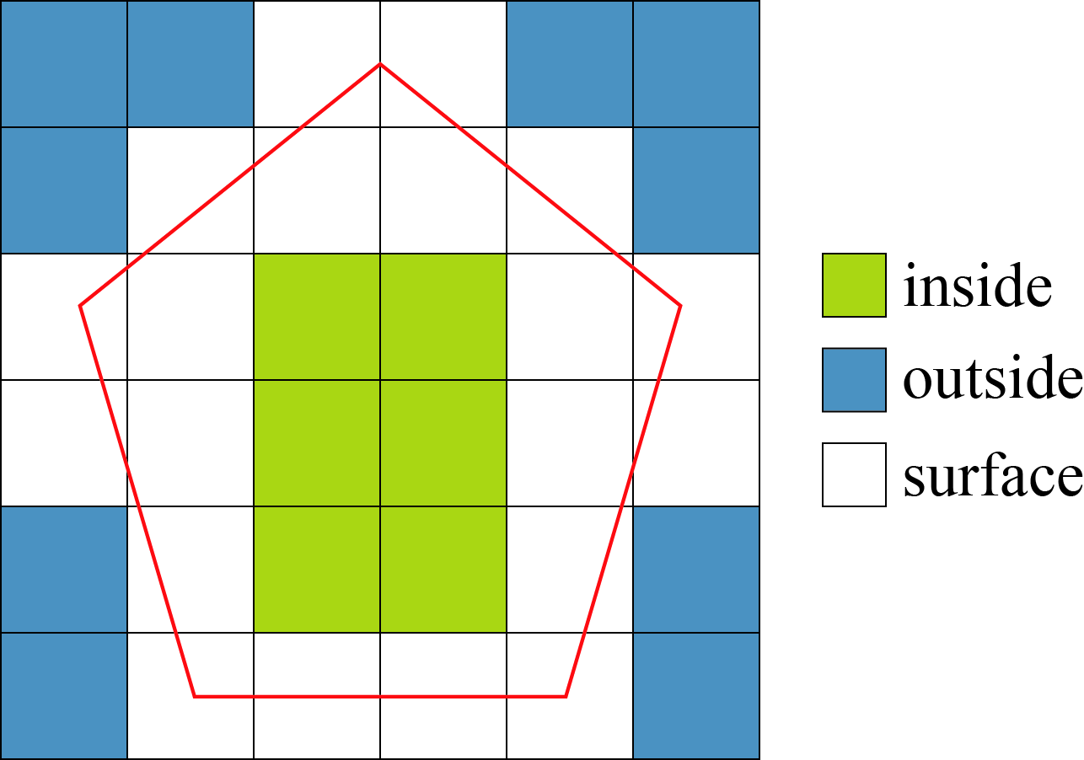
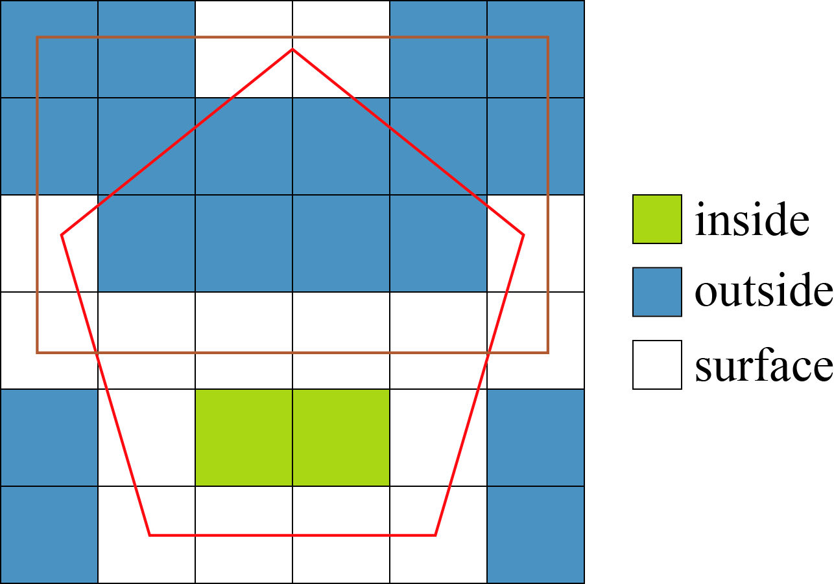
Cell classification

Slide 24
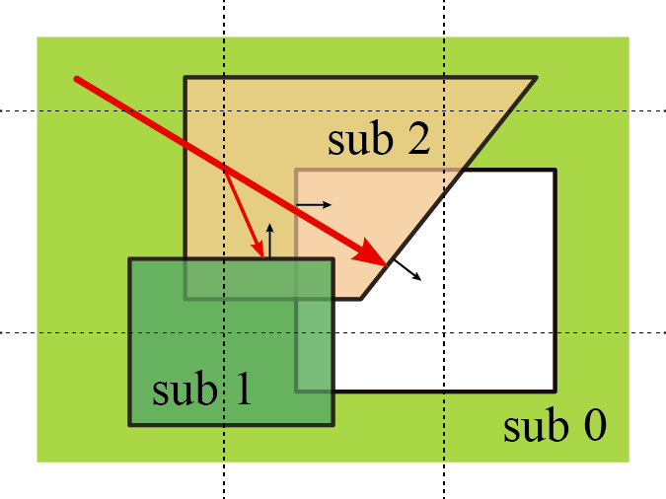
Open volumes

Slide 25
Triangle reduction

Slide 26
Optimization III
Hardware architecture

Slide 27
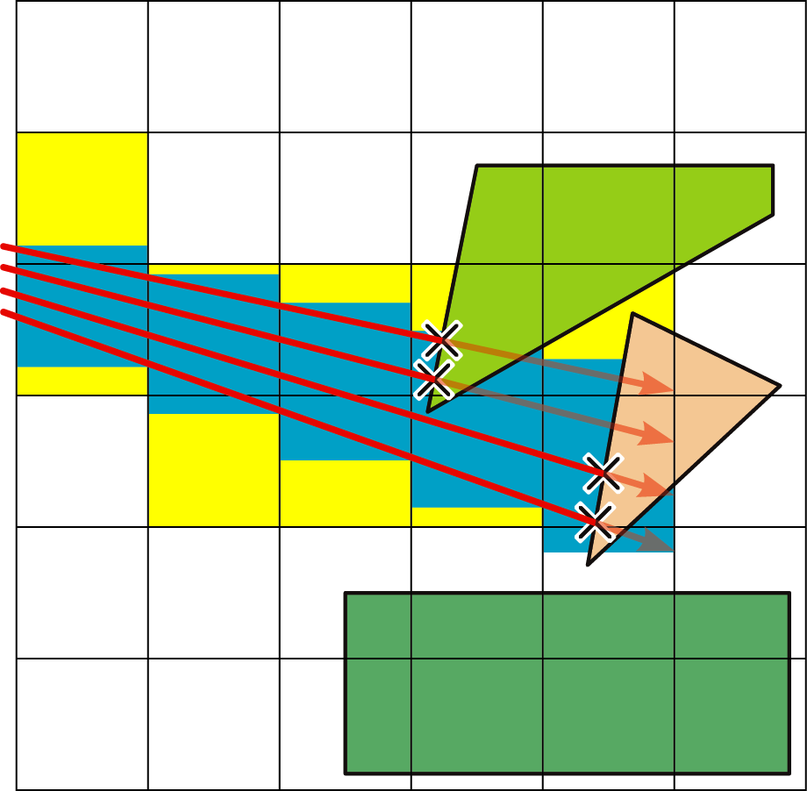
Vectorization and memory locality - Packets
Ray tracing animated scenes using coherent grid traversal, Ingo Wald et al., 2006

Slide 28
Results

Slide 29

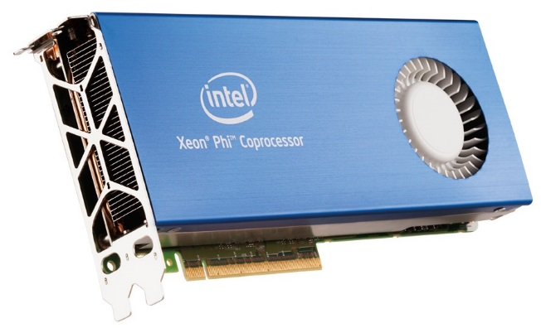
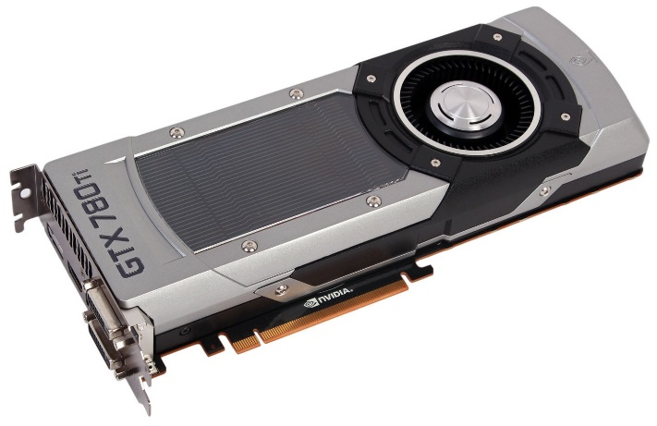
Runtime benchmark
http://www.pcper.com/reviews/Mobile/Intel-Core-i7-3720QM-Ivy-Bridge-Mobile-Review-Monster-Kill
http://www.anandtech.com/show/6265/intels-xeon-phi-in-10-petaflops-supercomputer
http://www.bit-tech.net/hardware/graphics/2013/11/07/nvidia-gtx-780-ti-3gb-review/1

Slide 30
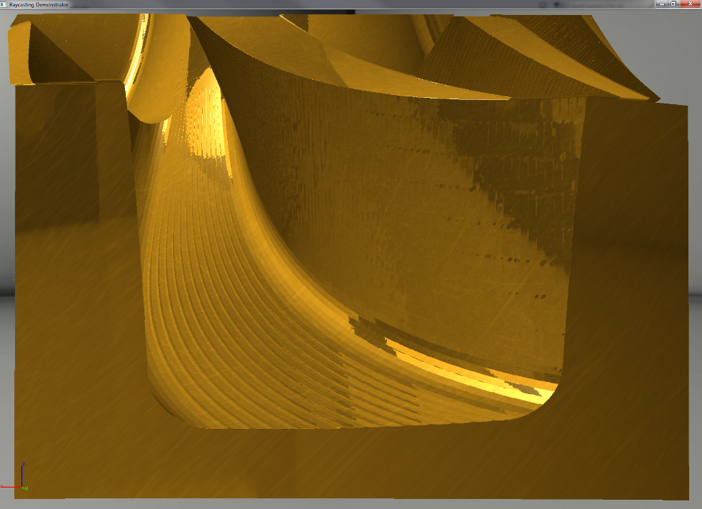
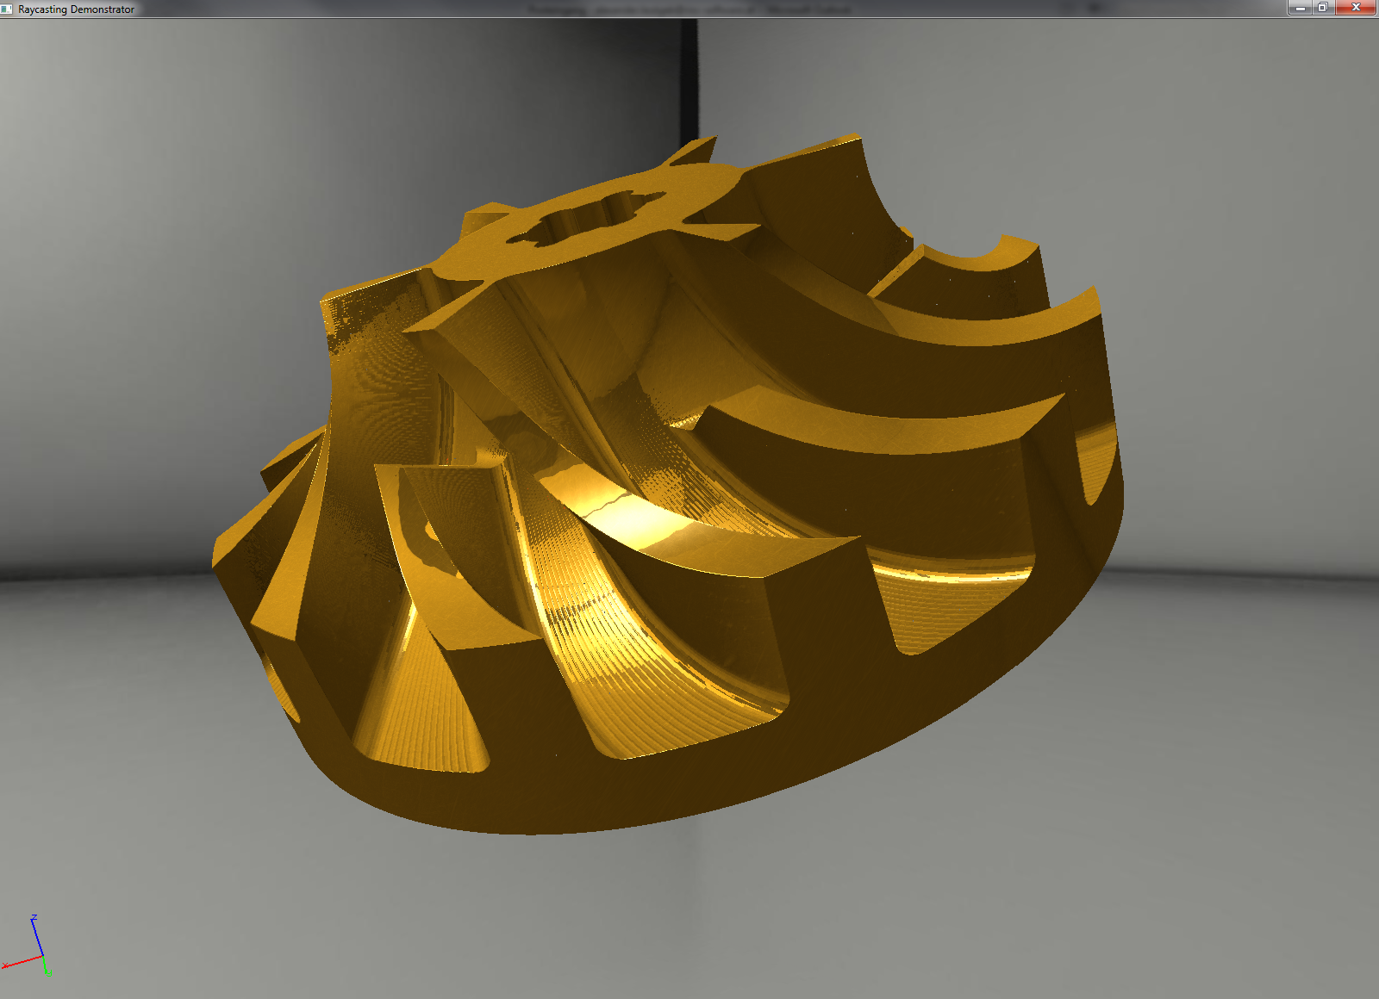
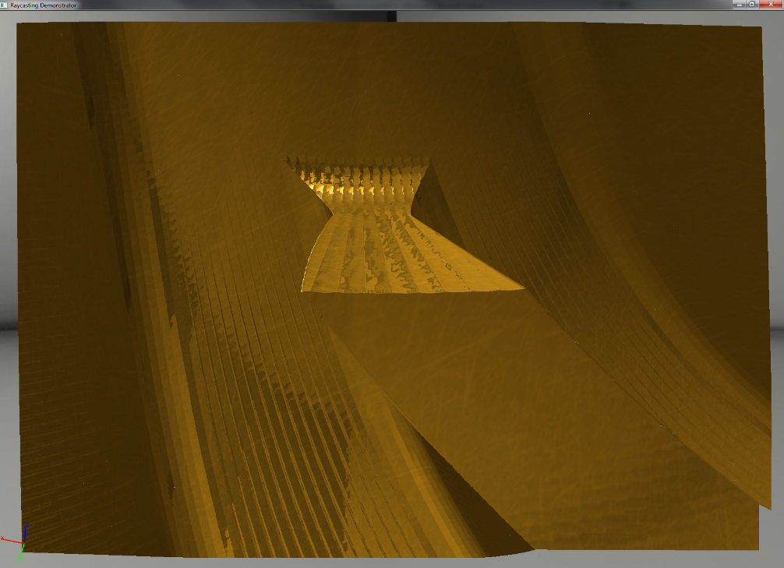
Visual quality

Slide 31
Master thesis
“Detailed and adaptive surface reconstruction of implicitly defined geometries”
Regular grid with swept volumes as input
Will (hopefully) calculate exact surface as triangle mesh
See you in December ;)

